Slide 1
Third Meeting of The Sensors Special Interest Group 29 April 2019

Slide 2
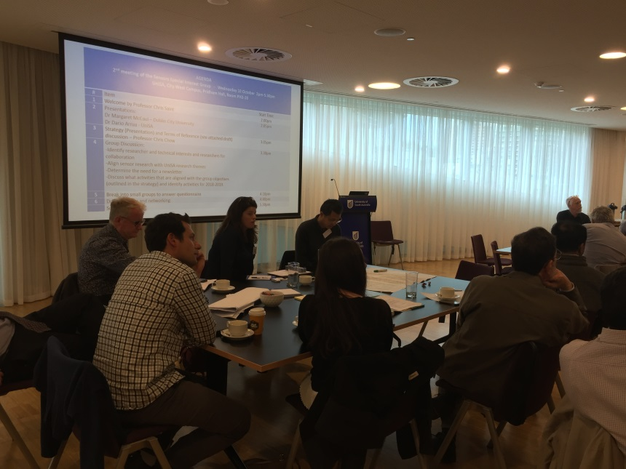
Background
The Sensors Special Interest Group, established in 2017, by Professor Christopher Saint and Professor Chris Chow, will provide strategic direction and leadership to ensure there is a mechanism to maximize UniSAs profile in the area of sensor development and application.
Membership includes UniSA Researchers in all disciplines, other University Researchers and industry members.
Previous meetings were held in December 2017 and October 2018.
http://www.unisa.edu.au/IT-Engineering-and-the-Environment/Research/sensors-special-interest-group-ssig/

Slide 3
Purpose of this meeting
This session will feature presentations on the latest sensor research, products and services that align with our group themes:
Health and Wellbeing
Environment
Sensor Systems
Asset Management.
A Panel of experts will talk about their collaborations with the university and share what current opportunities available for new collaborations.

Slide 4
# | Item |  | Start
1 | Welcome | Professor Chris Saint University of South Australia | 2:00
2 | Presentation – Health and Wellbeing Theme: Smart Wearable Sensors for Construction Worker Monitoring | Dr JoonOh Seo Hong Kong Polytechnic Uni | 2:10
3 | Presentation – Environmental Theme: Using online phycocyanin sensors to improve operational decision-making in water treatment processes | Dr Leon van der Linden SA Water | 2:35
4 | Presentation – Health and Wellbeing Theme: Technology for Managing Fatigue | Assoc Professor Jill Dorrian University of South Australia | 3:00
5 | Refreshments and networking | All | 3:25
6 | Presentation – Sensor Systems Theme: Sensor Systems | Professor Javaan Chahl University of South Australia | 4:00
7 | Q&A Session Chaired by Professor Chris Chow. Introductions by the Industry Panel Members followed by an opportunity for attendees to ask questions to the panel | All | 4:25
8 | Closing remarks | Professor Chris Chow University of South Australia | 5:25
Agenda:

Slide 5
Question and Answer (Q&A) Session
Panel Members:
Industry Team:
Adjunct Associate Professor Paul Monis - SA Water
Ms Amanda Mussared - SA Water
Dr Chris Walker - Clarity Aquatic
Presenter Team:
Dr JoonOh Seo - Hong Kong Polytechnic University
Dr Leon van der Linden - SA Water
Associate Professor Jill Dorrian - University of South Australia
Professor Javaan Chahl - University of South Australia

Slide 6
Industry Team Panel Introductions
Personal Introduction: organisation and role
Experience with Uni researchers / projects, how we (UniSA) can do better
How we (UniSA) can facilitate better linkage with industry and what they like to support
What current opportunities are available

Slide 7
Closing Remarks

