Slide 1
Sensors Special Interest Group
2nd Meeting
10/10/2018

Slide 2
Background
The Sensors Special Interest Group (SSIG), established in 2017, by Professor Christopher Saint and Professor Chris Chow, will provide strategic direction and leadership to ensure there is a mechanism to maximize UniSAs profile in the area of sensor development.
Membership includes UniSA Researchers in all disciplines, other University Researchers and industry members.

Slide 3
Purpose of this meeting
International Speaker – Dr Margaret McCaul, Team Leader, Research Fellow, National Centre for Sensor Research, Dublin City University
UniSA Speaker – Dr Dario Arrura, Foundation Fellow, Future Industries Institute. Talk title: Research at Separation Science Group
Help to develop the strategy of the SSIG

Slide 4
AGENDA 2nd meeting of the Sensors Special Interest Group - Wednesday 10 October 2pm-5.30pm UniSA, City West Campus, Pridham Hall, Room PH2-10
# | Item
1 | Welcome by Professor Chris Saint
2 | Presentations: Dr Margaret McCaul – Dublin City University Dr Dario Arrua - UniSA
3 | Strategy (Presentation) and Terms of Reference (see attached draft) discussion – Professor Chris Chow
4 | Group Discussion: -Identify researcher and technical interests and researchers for collaboration -Align sensor research with UniSA research themes -Determine the need for a newsletter -Discuss what activities that are aligned with the group objectives (outlined in the strategy) and identify activities for 2018-2019.
5 | Break into small groups to answer questionnaire
6 | Drinks, nibbles and networking
 | Session Close

Slide 5
Sensors Special Interest Group
Strategy and Terms of Reference
Discussion

Slide 6
Aims
The Sensor Special Group (SSG) aims to facilitate collaboration and knowledge sharing by providing opportunities to connect researchers working in all disciplines with the purpose of facilitating transfer of knowledge (industry sensor application trends) through face to face meetings and influencing development through learning opportunities (seminars) and perhaps with resources allow, online discussion groups.
The special group will benefit its members by raising awareness of advances and projects in the sensor development and application areas. It is also assisting in building a strong connected network of researchers in the sensor field with the industry. Members will then be able to tap into information and projects in the industry that are relevant for the work they do in their own research field with the knowledge that they are following a standard best practice.

Slide 7
Purpose of this meeting
Help to develop the strategy of the SSIG
Identify sensor researchers willing to collaborate
Align sensor research with our University research themes
Help to identify our research and technical interests
Determine the need for a newsletter
Discuss what activities that are aligned with one or more of the objectives above, that the group like to be organised?
Identify the activities for 2018-2019

Slide 8
Objectives
Engaging members to share news in the sensor field
Identifying industry champion as member to represent the sector as a trusted voice
Extending our reach to more industry sections
Building knowledge and skills in the sensing field to a particular sector
Closer collaboration of researchers and industry members

Slide 9
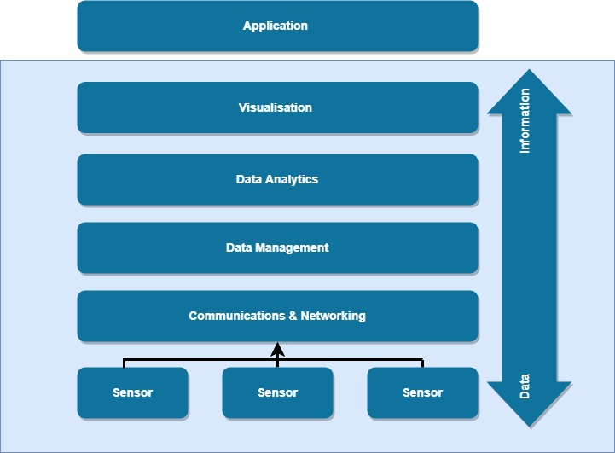
Sensor Questionnaire:

Slide 10
Sensor Questionnaire:
Where in the sensor systems value chain does your research operate?
In which area(s) does your research operate?
Describe the nature of your research and the role that sensors play in it
Which industries are you currently involved in and which industries would you like to be involved in?
Do you feel that your research could offer any activities or skills as services to others?
What sort of support do you need to progress your research?

Slide 11
Group Discussion
3:30pm

Slide 12
Group Discussion:
Identify researcher and technical interests and researchers for collaboration
Align sensor research with UniSA research themes
Determine the need for a newsletter
Discuss what activities that are aligned with the group objectives (outlined in the strategy) and identify activities for 2018-2019.

Slide 13
Break into small groups to answer questionnaire
4:10pm

